Slide 1
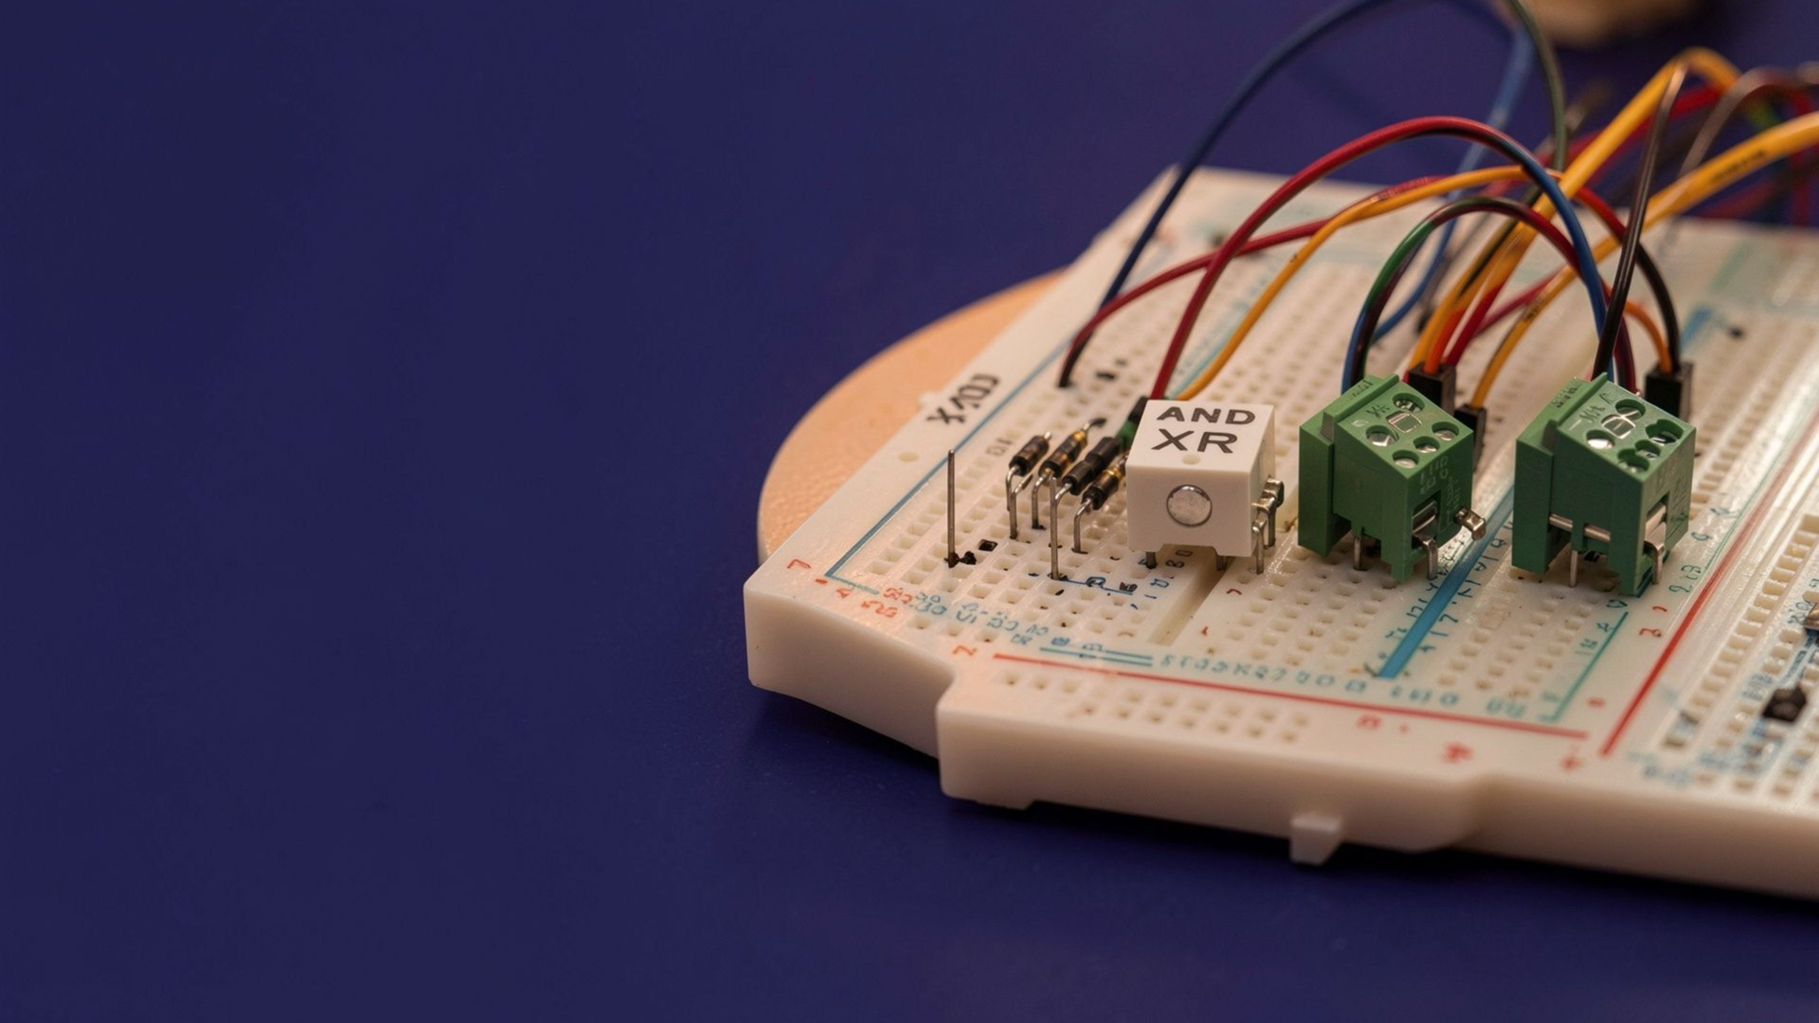
DDCA FINAL PROJECT · DIGITAL DESIGN AND COMPUTER ARCHITECTURE
Half Adder, Full Adder and a 4-bit Arithmetic Unit
Logic gates · carry propagation · Logisim verification
Team member | Roll number
Tanusree | 2620030047
Rishitha | 2620030062
Shreyasi | 2620030164
Aalakuntla Kumar | 2620030137
Section: ____
Notes:
Introduce the team and the project title. Roll numbers and section are on this slide. Fill in the section before presenting.

Slide 2
02 · INTRODUCTION
Introduction and Objective
What is this project?
Objectives
Every digital arithmetic circuit is built from binary addition, done one bit position at a time.
A half adder adds two bits. A full adder also accepts a carry-in, so it can be chained.
Four full adders connected in a ripple-carry chain form a 4-bit arithmetic unit.
The design is built from XOR, AND and OR gates and simulated in Logisim.
1
Design a half adder
XOR + AND give Sum and Carry
2
Design a full adder
Two half adders + an OR gate, with Cin
3
Build a 4-bit adder
Four full adders in a ripple-carry chain
4
Verify in Logisim
Check truth tables, carry flow and test sums
Notes:
Purpose: show how simple gates combine to perform multi-bit binary addition. Be ready to explain why a half adder alone is not enough for multi-bit numbers (no carry-in).

Slide 3
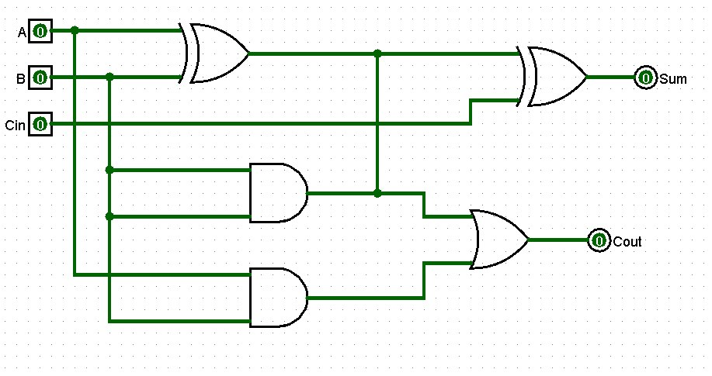
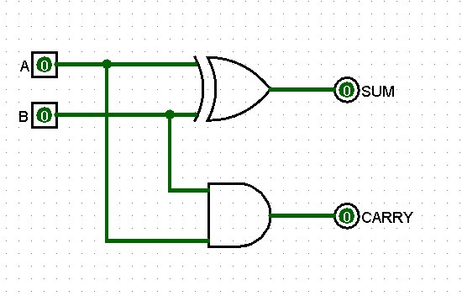
03 · THEORY
Theory and Logic Circuit
XOR A ⊕ B
1 when the inputs differ
AND A · B
1 only when both inputs are 1
OR A + B
1 when at least one input is 1
Half adder (inputs A, B)
Full adder (inputs A, B, Cin)
Sum S = A ⊕ B
Carry C = A · B
No carry-in, so it only suits the least-significant bit.
Sum S = A ⊕ B ⊕ Cin
Carry-out Cout = A·B + Cin·(A ⊕ B)
HA1 adds A and B; HA2 adds that sum to Cin; the OR gate merges the two carries.
Notes:
Walk through the gates first, then the half adder, then show the full adder is two half adders plus OR. Viva: derive Cout = AB + Cin(A xor B).

Slide 4
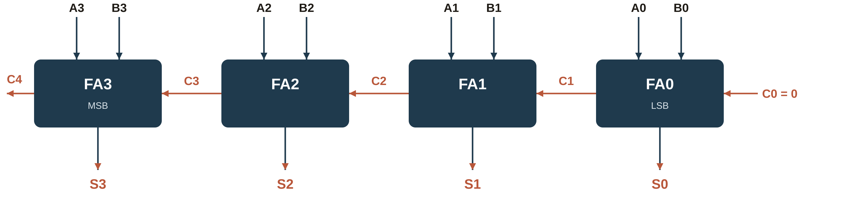
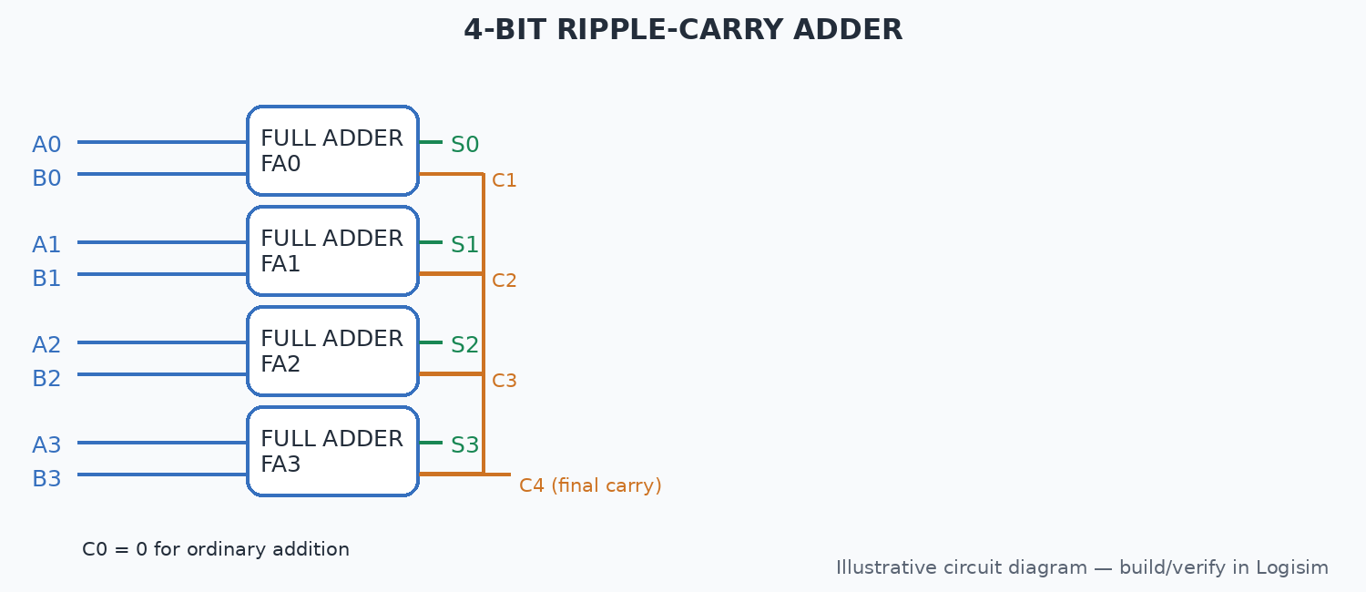
04 · IMPLEMENTATION
Circuit Design in Logisim
How it works
Build: gates → half adder → full adder → 4-bit adder, each saved as a subcircuit.
Inputs A3–A0 and B3–B0 are set with input pins; C0 is tied to 0 for addition.
Each FA passes its Cout to the next FA’s Cin: C0 → C1 → C2 → C3 → C4.
Outputs S3–S0 show the sum on LEDs; C4 is the final carry (overflow).
Notes:
Replace the dashed placeholder with a screenshot of your Logisim 4-bit adder. Explain that carry ripples from LSB to MSB, so each stage waits for the previous one.

Slide 5
05 · VERIFICATION
Simulation Results
Half adder
Full adder
A | B | S | C
0 | 0 | 0 | 0
0 | 1 | 1 | 0
1 | 0 | 1 | 0
1 | 1 | 0 | 1
A | B | Cin | S | Cout
0 | 0 | 0 | 0 | 0
0 | 0 | 1 | 1 | 0
0 | 1 | 0 | 1 | 0
0 | 1 | 1 | 0 | 1
1 | 0 | 0 | 1 | 0
1 | 0 | 1 | 0 | 1
1 | 1 | 0 | 0 | 1
1 | 1 | 1 | 1 | 1
4-bit adder test cases (C0 = 0)
A | B | Sum (S3–S0) | C4 | Decimal
0011 | 0101 | 1000 | 0 | 3 + 5 = 8
0111 | 0111 | 1110 | 0 | 7 + 7 = 14
1001 | 0110 | 1111 | 0 | 9 + 6 = 15
1111 | 0001 | 0000 | 1 | 15 + 1 = 16
1111 | 1111 | 1110 | 1 | 15 + 15 = 30
Observations
Outputs match the truth tables for every input combination.
C4 = 1 when the sum exceeds 15, which signals overflow of 4 bits.
Notes:
Replace the two placeholders with real Logisim screenshots. Re-check each table row in Logisim before presenting; the 4-bit rows are hand-verified expected results.

Slide 6
06 · SUMMARY
Conclusion and Applications
Outcome
Applications
Possible improvements
XOR, AND and OR gates are enough to build reliable binary adders.
Half adder → full adder → 4-bit unit by modular reuse.
Logisim simulation matched all truth tables and test sums, including overflow on C4.
ALUs and processor datapaths
Address generation and program counters
Calculators, counters and digital signal hardware
Add subtraction (invert B, set C0 = 1) using 2’s complement
Add logic operations (AND, OR, XOR) to make a small ALU
Use carry-lookahead logic to cut the ripple-carry delay
Trade-off: ripple-carry is compact and low-cost but slows as width grows, since every stage waits for the previous carry.
Notes:
Summarise, then be ready for viva: why ripple-carry is slow, how carry-lookahead helps, how subtraction reuses the adder.

